Slide 1
Data Wrangling (I): Munging, Tidy Data, and Working with Multiple Data Tables
Nicholas Mattei, Tulane University
CMPS3660 – Introduction to Data Science – Fall 2019
https://rebrand.ly/TUDataScience
Many Thanks
Slides based off Introduction to Data Science from John P. Dickerson - https://cmsc320.github.io/

Slide 2
Announcements
Project1 and Milestone1 Updates
Reading really important here!
Survey Results!
Lab 4 + Lab 5
Weekly Questions 4
On to DATA!

Slide 3
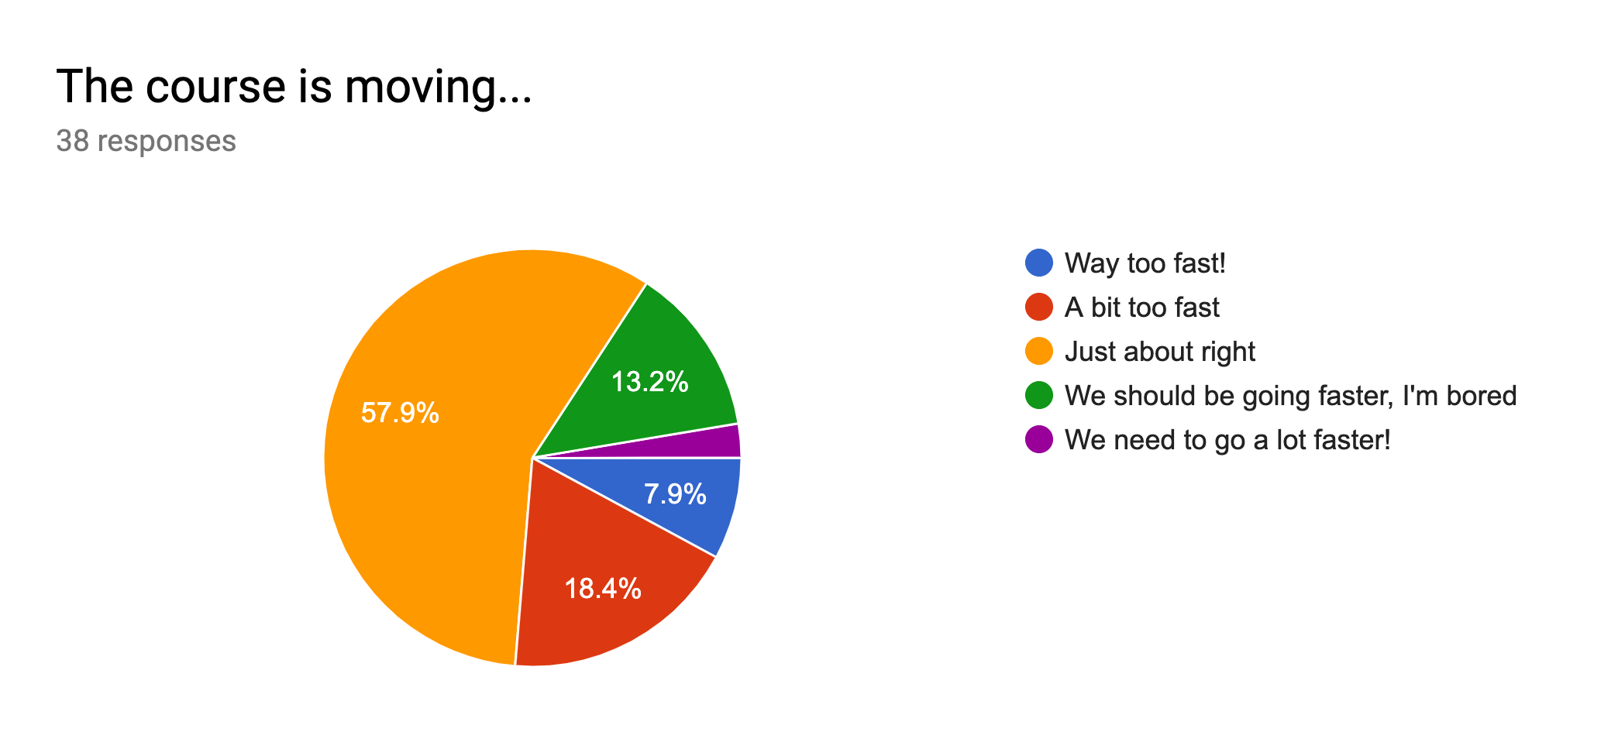
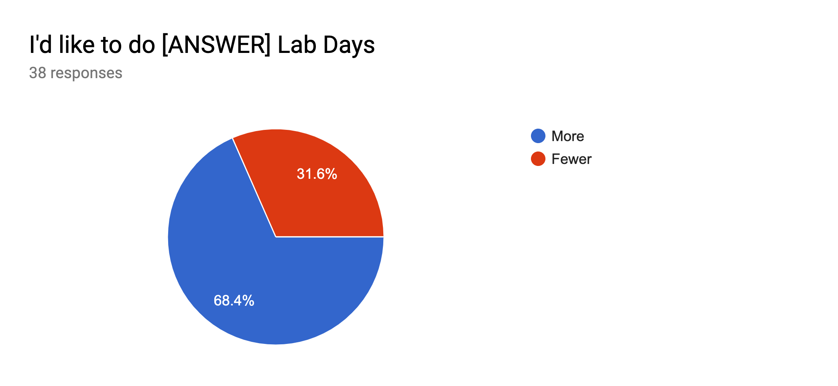
Survey Take Home Messages
28+ of you like or really like notebooks!
2 of you really hate them!
Some of you say I’m talking too fast!
6-7 of you Hate Docker!
What we want (that I’ll deliver):
More Depth, More Theory (5)
PPT/Lectures (5-7)?
Too much, Not enough; interesting, boring; clear, too muddled.
More Feedback!
What we want (I can’t fix).
Class too early.
Too much programming.

Slide 4
Next Couple of Lectures (Till Midterm)
Tables in the Abstract
How, Why
Operations
Principles of Tidy Data
Tables in Pandas
Tables in SQL and RMDBS
2 More Labs.

Slide 5
The Data LifeCycle
Data Collection
Data Processing
Exploratory Analysis
&
Data Visualization
Analysis, Hypothesis Testing,
& ML
Insight
&
Policy Decision
Today

Slide 6
Tables
Special Column, called “Index”, or “ID”, or “Key”
Usually, no duplicates Allowed
Variables
(also called Attributes, or Columns, or Labels)
ID | age | wgt_kg | hgt_cm
1 | 12.2 | 42.3 | 145.1
2 | 11.0 | 40.8 | 143.8
3 | 15.6 | 65.3 | 165.3
4 | 35.1 | 84.2 | 185.8
Observations,
Rows, or
Tuples
Entries or values

Slide 7
1. Select/Slicing
Select only some of the rows, or some of the columns, or a combination.
ID | age
1 | 12.2
2 | 11.0
3 | 15.6
4 | 35.1
ID | age | wgt_kg | hgt_cm
1 | 12.2 | 42.3 | 145.1
2 | 11.0 | 40.8 | 143.8
3 | 15.6 | 65.3 | 165.3
4 | 35.1 | 84.2 | 185.8
Only columns
ID and Age
Both
Only rows with wgt > 41
ID | age
1 | 12.2
3 | 15.6
4 | 35.1
ID | age | wgt_kg | hgt_cm
1 | 12.2 | 42.3 | 145.1
3 | 15.6 | 65.3 | 165.3
4 | 35.1 | 84.2 | 185.8

Slide 8
2. Aggregate/Reduce
Combine values across a column into a single value
73.9 | 232.6 | 640.0
ID | age | wgt_kg | hgt_cm
1 | 12.2 | 42.3 | 145.1
2 | 11.0 | 40.8 | 143.8
3 | 15.6 | 65.3 | 165.3
4 | 35.1 | 84.2 | 185.8
SUM
MAX
35.1 | 84.2 | 185.8
SUM(wgt_kg^2 - hgt_cm)
What about ID/Index column?
Usually not meaningful to aggregate across it
May need to explicitly add an ID column
14167.66

Slide 9
Practical Interlude: np.nan
ID | age | wgt_kg | hgt_cm
1 | 12.2 | 42.3 | 145.1
2 | 11.0 | 40.8 | 143.8
3 | 15.6 | 65.3 | 165.3
4 | -- | 84.2 | 185.8
We use numpy.nan to signify a value is missing or not a number.
If we don’t use NaN’s then Pandas doesn’t know how to handle the data.
Breaks in all sorts of awful ways.
(Demo Notebook)
SUM
ERROR!
ID | age | wgt_kg | hgt_cm
1 | 12.2 | 42.3 | 145.1
2 | 11.0 | 40.8 | 143.8
3 | 15.6 | 65.3 | 165.3
4 | np.NaN | 84.2 | 185.8
SUM
38.8

Slide 10
3. Map
Apply a function to every row, possibly creating more or fewer columns
ID | Address
1 | College Park, MD, 20742
2 | Washington, DC, 20001
3 | Silver Spring, MD 20901
ID | City | State | Zipcode
1 | College Park | MD | 20742
2 | Washington | DC | 20001
3 | Silver Spring | MD | 20901
SPLIT(“,”)
Variations that allow one row to generate multiple rows in the output (sometimes called “flatmap” or “melt” as we’ll see later.)

Slide 11
4. Group By
A = foo
Group tuples together by column/dimension.
ID | B | C
1 | 3 | 6.6
3 | 4 | 3.1
4 | 3 | 8.0
7 | 4 | 2.3
8 | 3 | 8.0
ID | A | B | C
1 | foo | 3 | 6.6
2 | bar | 2 | 4.7
3 | foo | 4 | 3.1
4 | foo | 3 | 8.0
5 | bar | 1 | 1.2
6 | bar | 2 | 2.5
7 | foo | 4 | 2.3
8 | foo | 3 | 8.0
By ‘A’
A = bar
ID | B | C
2 | 2 | 4.7
5 | 1 | 1.2
6 | 2 | 2.5

Slide 12
4. Group By
B = 1
ID | A | C
5 | bar | 1.2
Group tuples together by column/dimension.
B = 2
ID | A | C
2 | bar | 4.7
6 | bar | 2.5
ID | A | B | C
1 | foo | 3 | 6.6
2 | bar | 2 | 4.7
3 | foo | 4 | 3.1
4 | foo | 3 | 8.0
5 | bar | 1 | 1.2
6 | bar | 2 | 2.5
7 | foo | 4 | 2.3
8 | foo | 3 | 8.0
B = 3
By ‘B’
ID | A | C
1 | foo | 6.6
4 | foo | 8.0
8 | foo | 8.0
B = 4
ID | A | C
3 | foo | 3.1
7 | foo | 2.3

Slide 13
4. Group By
Group tuples together by column/dimension.
A = foo, B = 3
A = bar, B = 1
ID | C
1 | 6.6
4 | 8.0
8 | 8.0
ID | A | B | C
1 | foo | 3 | 6.6
2 | bar | 2 | 4.7
3 | foo | 4 | 3.1
4 | foo | 3 | 8.0
5 | bar | 1 | 1.2
6 | bar | 2 | 2.5
7 | foo | 4 | 2.3
8 | foo | 3 | 8.0
ID | C
5 | 1.2
By ‘A’, ‘B’
A = bar, B = 2
ID | C
2 | 4.7
6 | 2.5
A = foo, B = 4
ID | C
3 | 3.1
7 | 2.3

Slide 14
5. Group By Aggregate
B = 1
B = 1
ID | A | C
5 | bar | 1.2
Sum (C)
1.2
B = 2
Group the aggregate per group.
ID | A | C
2 | bar | 4.7
6 | bar | 2.5
B = 2
Sum (C)
7.2
ID | A | B | C
1 | foo | 3 | 6.6
2 | bar | 2 | 4.7
3 | foo | 4 | 3.1
4 | foo | 3 | 8.0
5 | bar | 1 | 1.2
6 | bar | 2 | 2.5
7 | foo | 4 | 2.3
8 | foo | 3 | 8.0
B = 3
B = 3
ID | A | C
1 | foo | 6.6
4 | foo | 8.0
8 | foo | 8.0
Group by ‘B’
Sum on C
Sum (C)
22.6
B = 4
B = 4
Sum (C)
5.4
ID | A | C
3 | foo | 3.1
7 | foo | 2.3

Slide 15
5. Group By Aggregate
B = 1
Sum (C)
1.2
Final result usually seen as a table.
B = 2
Sum (C)
7.2
ID | A | B | C
1 | foo | 3 | 6.6
2 | bar | 2 | 4.7
3 | foo | 4 | 3.1
4 | foo | 3 | 8.0
5 | bar | 1 | 1.2
6 | bar | 2 | 2.5
7 | foo | 4 | 2.3
8 | foo | 3 | 8.0
B | SUM(C )
1 | 1.2
2 | 7.2
3 | 22.6
4 | 5.4
B = 3
Group by ‘B’
Sum on C
Sum (C)
22.6
B = 4
Sum (C)
5.4

Slide 16
5.5 Pivot Tables (Data Cubes)
Laying out the possible values of multiple axes and aggregating them.
Can have more than two dimensions, need hierarchal indexes (later).
ID | A | B | C
1 | foo | 3 | 6.6
2 | bar | 2 | 4.7
3 | foo | 4 | 3.1
4 | foo | 3 | 8.0
5 | bar | 1 | 1.2
6 | bar | 2 | 2.5
7 | foo | 4 | 2.3
8 | foo | 3 | 8.0
A B> | 1 | 2 | 3 | 4
foo | 0 | 0 | 22.6 | 5.4
bar | 1.2 | 7.2 | 0 | 0
Index A, Columns B
Values C, Agg=Sum

Slide 17
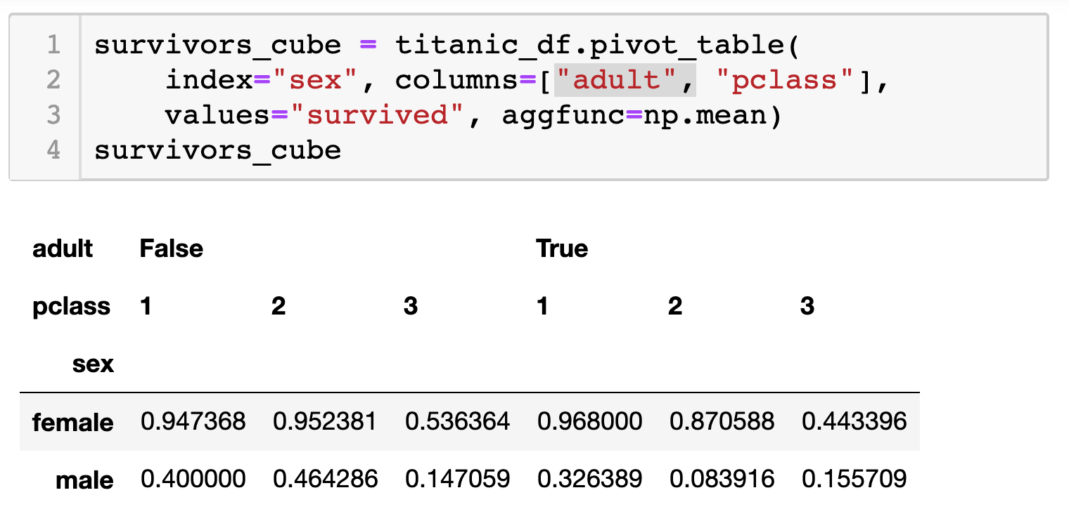
5.5 Pivot Tables (Data Cubes)
Laying out the possible values of multiple axes and aggregating them.
Can have more than two dimensions, need hierarchal indexes (later).

Slide 18
6. Union/Intersection/Difference
Set operations – only if the two tables have identical attributes/columns
ID | A | B | C
1 | foo | 3 | 6.6
2 | bar | 2 | 4.7
3 | foo | 4 | 3.1
4 | foo | 3 | 8.0
5 | bar | 1 | 1.2
6 | bar | 2 | 2.5
7 | foo | 4 | 2.3
8 | foo | 3 | 8.0
ID | A | B | C
1 | foo | 3 | 6.6
2 | bar | 2 | 4.7
3 | foo | 4 | 3.1
4 | foo | 3 | 8.0
ID | A | B | C
5 | bar | 1 | 1.2
6 | bar | 2 | 2.5
7 | foo | 4 | 2.3
8 | foo | 3 | 8.0
U
Similarly Intersection and Set Difference manipulate tables as Sets
IDs may be treated in different ways, resulting in somewhat different behaviors

Slide 19
7. Merge or Join
Combine rows/tuples across two tables if they have the same key.
This example is called an Inner Join
ID | A | B
1 | foo | 3
2 | bar | 2
3 | foo | 4
4 | foo | 3
ID | C
1 | 1.2
2 | 2.5
3 | 2.3
5 | 8.0
ID | A | B | C
1 | foo | 3 | 1.2
2 | bar | 2 | 2.5
3 | foo | 4 | 2.3
⨝
What about IDs not present in both tables?
Often need to keep them around
Can “pad” with NaN (depends on software!)

Slide 20
7. Merge or Join (Outer or Full Join)
Combine rows/tuples across two tables if they have the same key.
Outer joins can be used to ”pad” IDs that don’t appear in both tables
Three variants: LEFT, RIGHT, FULL
SQL Terminology -- Pandas has these operations as well
ID | A | B
1 | foo | 3
2 | bar | 2
3 | foo | 4
4 | foo | 3
ID | C
1 | 1.2
2 | 2.5
3 | 2.3
5 | 8.0
ID | A | B | C
1 | foo | 3 | 1.2
2 | bar | 2 | 2.5
3 | foo | 4 | 2.3
4 | foo | 3 | NaN
5 | NaN | NaN | 8.0
⟗

Slide 21
Types of Joins
In Pandas this is called a FULL OUTTER JOIN!
⨝
⟗
⟕
⟖
Image credit: http://www.dofactory.com/sql/join

Slide 22
7. Merge or Join (Left Join)
Combine rows/tuples across two tables if they have the same key.
Outer joins can be used to ”pad” IDs that don’t appear in both tables
Three variants: LEFT, RIGHT, FULL
SQL Terminology -- Pandas has these operations as well
ID | A | B
1 | foo | 3
2 | bar | 2
3 | foo | 4
4 | foo | 3
ID | C
1 | 1.2
2 | 2.5
3 | 2.3
5 | 8.0
ID | A | B | C
1 | foo | 3 | 1.2
2 | bar | 2 | 2.5
3 | foo | 4 | 2.3
4 | foo | 3 | NaN
⟕

Slide 23
7. Merge or Join (Right Join)
Combine rows/tuples across two tables if they have the same key.
Outer joins can be used to ”pad” IDs that don’t appear in both tables
Three variants: LEFT, RIGHT, FULL
SQL Terminology -- Pandas has these operations as well
ID | A | B
1 | foo | 3
2 | bar | 2
3 | foo | 4
4 | foo | 3
ID | C
1 | 1.2
2 | 2.5
3 | 2.3
5 | 8.0
ID | A | B | C
1 | foo | 3 | 1.2
2 | bar | 2 | 2.5
3 | foo | 4 | 2.3
5 | NaN | NaN | 8.0
⟖

Slide 24
Quick Review
Tables: A simple, common abstraction
Subsumes a set of “strings” – a common input, or a list of lists, or a list of dicts with the same keys.
Operations on tables:
Select, Map, Aggregate, Reduce, Join/Merge, Union/Concat, Group By
These may have different names! In Pandas it’s a merge while in SQL it’s a join.
Actually, this isn’t quite right -- Pandas has a join command that will only join based on the index! It also has a merge command that allows for more options – see Lab 7!
Pandas also uses merge as we’ll see in lab while SQL uses Union
There can be subtle variations in implementation on different data systems. Remember I’m giving you the high level but you need to read the docs for your software when you use this stuff!

